Slide 1

Smart calculator in python
Guided Project
Woxsen University S.O.T
L.E.A.P Program
A python based Mini-Project
Project By-
Himanshu Pandit
B.Tech CSE AI & ML

Slide 2
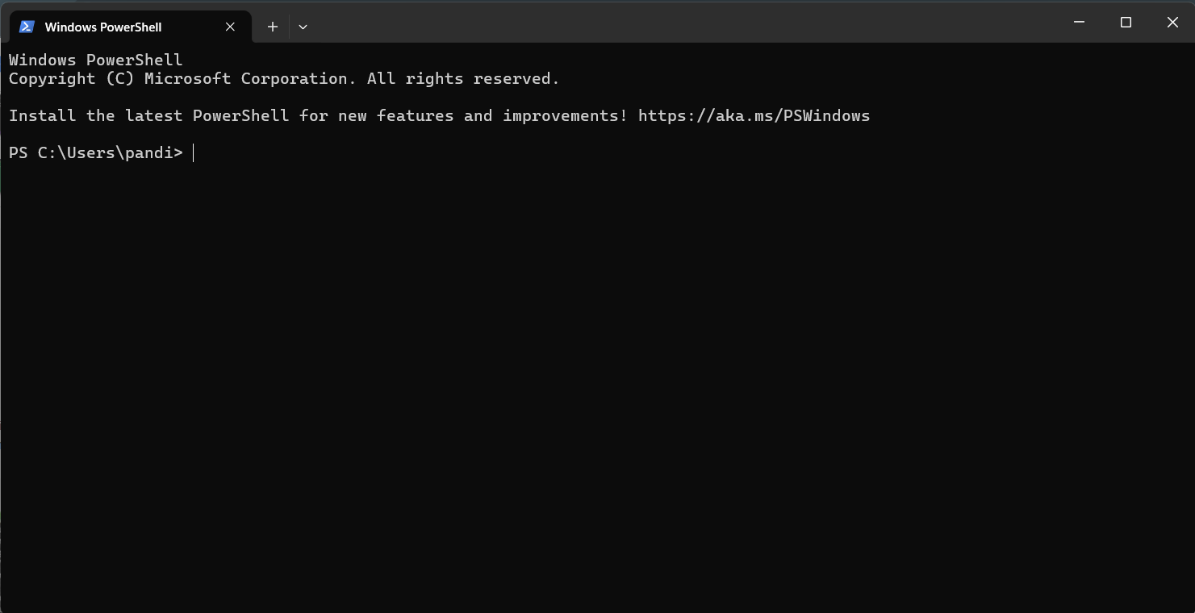
print(“Agenda”)
To present a Python-based smart calculator designed for everyday arithmetic use.
To explain working mechanism and code structure used in this program.
To showcase the real time working of the calculator and working of the code
To showcase the tools and logic applied to make the calculator user-friendly and efficient.

Slide 3

Tools, Technology & Environment
Programming Language: Python v.3 due to it’s simplicity.
IDE Used: VS Code provided debugging and live testing support.
Logic Structure: Menu-driven interface built using ‘if’ , “else” , “elif” , “input()”.
Libraries Used: Only built-in Python functions no external libraries were utilized.
Project Type: Command line application runs on any system with Python installed.

Slide 4

Why Python?
Python’s clean, English-like syntax makes it ideal for beginners and quick prototyping.
You can build functional projects like calculators with fewer lines of code compared to C++ or Java.
Python allows students to focus on how the logic works, not just syntax rules.
Python provides built-in support for arithmetic operations, conditionals, and user input without needing extra libraries.

Slide 5
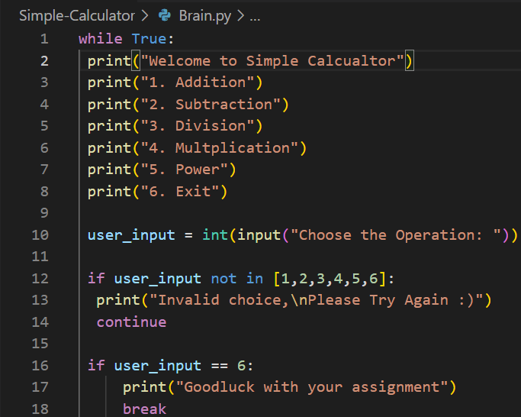
Looping
User Input Handling
Menu Display
“while true” creates an infinite loop that ensures the calculator keeps running until the user chooses to exit.
The menu options 1-6 are displayed every time the loop runs using the multiple “print()” statements.
“user_input = int(input())” collects the user’s choice of input and “int” make sures it is stored as an integer
The “ if user_input not in [1,2,3,4,5,6]” makes sure that that if anything from outside other than present inputs an error will be displays saying “Invalid Choice”.
If the input is 6 then the program is closed displaying “Goodluck with your assignment” this is due to the “if break” commands.

Slide 6
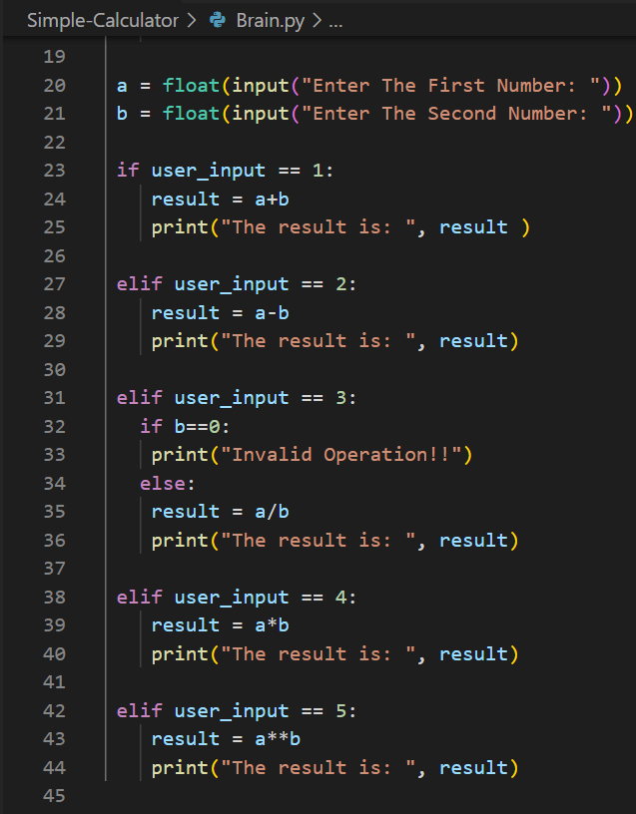
Conditional logic & Arithmetic Operations
The calculator uses a series od “if”, ”elif”, “else” statement to decide which operation to execute on the basis of user’s input
Now if user’s input is 1 then it asks for input of First and Second Number with the help of “input()” command and now it adds both numbers and give the result accordingly to all the rest of arithmetic operations
In division it makes sure that the neither of both number should be 0 because division by 0 is absurd.
After providing the result the calculator goes back into the loop due to “while true” command

Slide 7
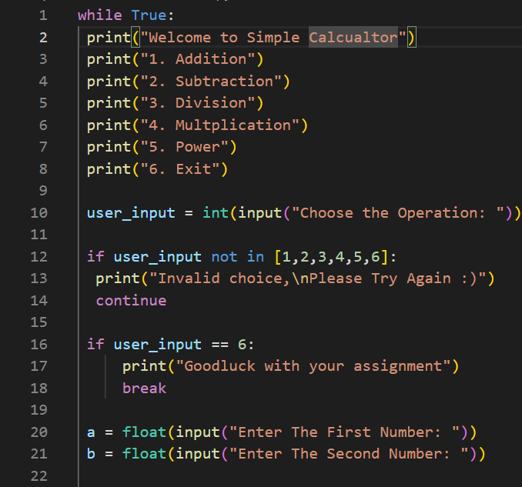
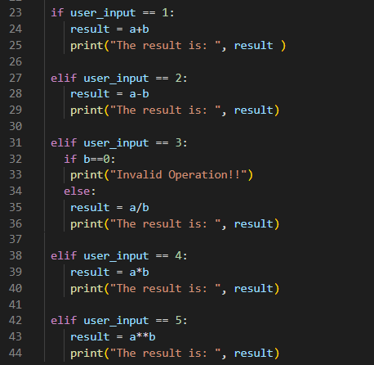
Final Code

Slide 8
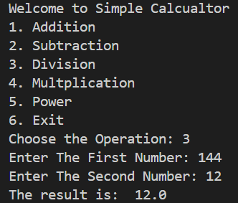
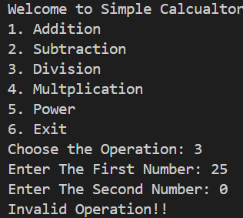
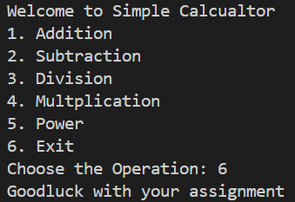
Output
Example Output 1:
Example Output 2 :
Example Output 3:
Here as we first choose 3 which corresponds to division it asked for two numbers and divided them and gave the results and went back into the loop.
Here first we chose 3 which corresponds to division, it asked for two numbers but as one of the number was 0 it returned an error and went back into the loop.
Here first we chose 6 which corresponds to exit so it eliminated the program with a goodbye message,

Slide 9
Conclusion
Build
Developed a working command calculator using Python.
Refine
Improved program reliability with input validation and error handling (Ex: divide by zero).
Learn
Understood how loops and choices work in a program.
Applied core concepts like loops, conditional and input effectively.
Structured the logic in a clear, readable, and expandable format.
Felt more confident writing and explaining code on my own.

Slide 10
THANK YOU

